Slide 1
SysLink 应用基础
SYS/BIOS 基础
双核工程开发
SysLink 组件

Slide 2
SysLink 组件
SysLink 组件
SysLink / IPC 通信代码流程
SysLink / IPC 组件的使用
Notify
ListMP、GateMP
Heap*MP、Memory、ShareRegion
MessageQ
RingIO
MultiProc & ProcMgr & Cache
NameServer
List & Gate
关于组件配置

Slide 3
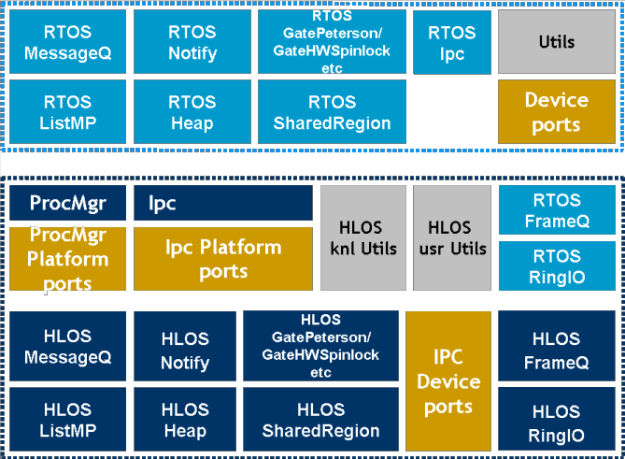
1、SysLink 模块
SysLink API：
IPC Product：
System APIs：
SysLink
Slave processor management APIs:
ProcMgr
Low-level IPC-related APIs
Ipc
Ipc (host only)
GateMP
HeapBufMP
HeapMemMP
HeapMultiBufMP
ListMP
MessageQ
MultiProc
NameServer
Notify
SharedRegion
High-level data transfer APIs:
FrameQ
RingIO
Utility APIs:
Cache
Gate
List
Memory
SysLink Product：

Slide 4
2、IPC 通信代码流程
SysLink / IPC 初始化相关 API 说明：
Ipc_start：
从 ID 为 0 的共享内寸区获取内存进行 IPC 基础模块和资源的初始化。如果在调用 Ipc_start 时，ID 为 0 的共享内存区还为被建立（由该内存区的 Onwer 建立），则会返回 Ipc_E_NOTREADY，这时应该再 次调用 Ipc_start，以完成初始化工作。对于 SYS/BIOS 如果 Ipc.procSync 被设置成 Ipc.ProcSync_ALL，那么在内部 会调用 Ipc_attach。
Ipc_attach:
Open 默认建立的几个 IPC 模块，并与多核系统中的其他处理器建立连接，需依次调用以连接其他处理 器。（ ID为 0 的共享内存区的 onwer 处理器作为首位）while (Ipc_attach(remoteProcId) < 0) { Task_sleep(1); }
Ipc_detach:
断开与其它处理器的连接。需依次与其他处理器断开（ID为 0 的共享内存区的 onwer 处理器作为首位）
while (Ipc_attach(remoteProcId) < 0) { Task_sleep(1); }
SysLink_setup: 初始化 SysLink 资源 SysLink_destroy: 释放 SysLink 资源
Ipc_control: 根据 Command ID 执行相应从处理器的 IPC 控制操作

Slide 5
RTOS IPC 头文件引入：
API 的错误处理：
/* ---- XDC Base Headers */ #include <xdc/std.h>
#include <string.h>
/* ---- XDC.RUNTIME module Headers */
#include <xdc/runtime/Memory.h>
#include <xdc/runtime/System.h>
#include <xdc/runtime/IHeap.h>
/* ----- IPC module Headers */
#include <ti/ipc/GateMP.h>
#include <ti/ipc/Ipc.h>
#include <ti/ipc/MessageQ.h>
#include <ti/ipc/HeapBufMP.h>
#include <ti/ipc/MultiProc.h>
/* ---- BIOS6 module Headers */
#include <ti/sysbios/BIOS.h>
#include <ti/sysbios/knl/Task.h>
/* ---- Get globals from .cfg Header */
#include <xdc/cfg/global.h>
............
Int status;
status = SysLink_api(param1, param2);
if (status >= 0) {
printf(”successful. Status [0x%x]", status);
}
else {
printf(”failed. Status [0x%x]", status);
}
............
............
............
............
............
............
............
............
............
do {
status = MessageQ_open (msgqName,
&MessageQApp_queueId [info->procId]);
} while (status == MessageQ_E_NOTFOUND);

Slide 6
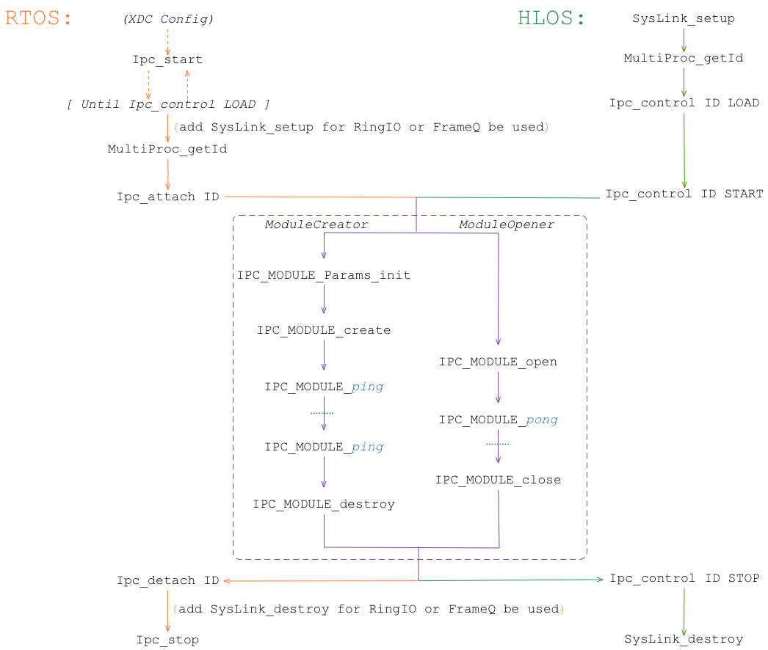
基本代码流程：

Slide 7
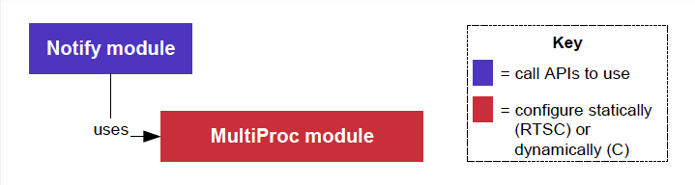
3、SysLink / IPC 组件的使用
1. Notify
Notify：最简单的核间通知机制，支持最多32bit 的数据传输
void cbFxn(UInt16 procId, UInt16 lineId, UInt32 eventId, UArg arg, UInt32 payload);
Notify_registerEvent(armProcId, 0, EVENTID, (Notify_FnNotifyCbck)cbFxn, 0x1010);
Notify_sendEvent(armProcId, 0, EVENTID, seq, TRUE);

Slide 8
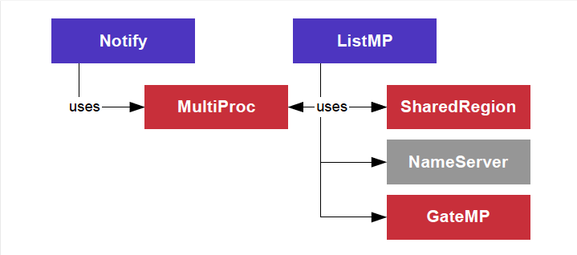
2. ListMP、GateMP
ListMP：多核间进行数据存储和传输的双向循环链表结构
gateHandle = GateMP_getDefaultRemote();
ListMP_Params_init(&params);
params.gate = gateHandle;
params.name = "myListMP";
params.regionId = 1;
handle1 = ListMP_create(&params, NULL); ...
ListMp_delete(&handle1);
ListMP_open(“myListMP”, &handle1, NULL)；
...
ListMP_close(&handle1);
typedef struct Tester {
ListMP_Elem elem;
Int scratch[30];
Int flag;
} Tester;
ListMP_prev(handle, elem))；
ListMP_empty(handle1)
ListMP_putTail(handle1, elem);
...
...

Slide 9
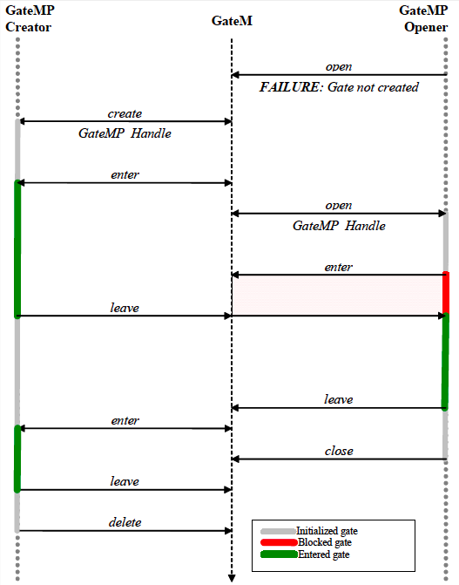
GateMP：多核间同步的互斥锁
GateMP_Params_init(&gparams);
gparams.localProtect = GateMP_LocalProtect_THREAD;
gparams.remoteProtect = GateMP_RemoteProtect_SYSTEM;
gparams.name = "myGate";
gparams.regionId = 1;
gateHandle = GateMP_create(&gparams, NULL); ... GateMP_delete(&gateHandle);
GateMP_open("myGate", &gateHandle); ... GateMP_close(&gateHandle);
IArg key;
/* Enter the gate */
key = GateMP_enter(gateHandle);
...
/* Leave the gate */
GateMP_leave(gateHandle, key);

Slide 10
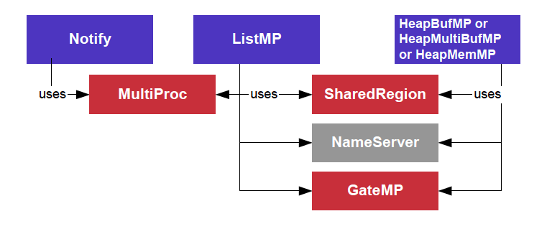
3. Heap*MP、Memory、ShareRegion
HeapBufMP：固定大小的内存管理
HeapMultiBufMP:支持8种固定的不同大小的内存管理
HeapMemMP:不固定大小的内存管理
Memory：内存分配与释放以及地址转换

Slide 11
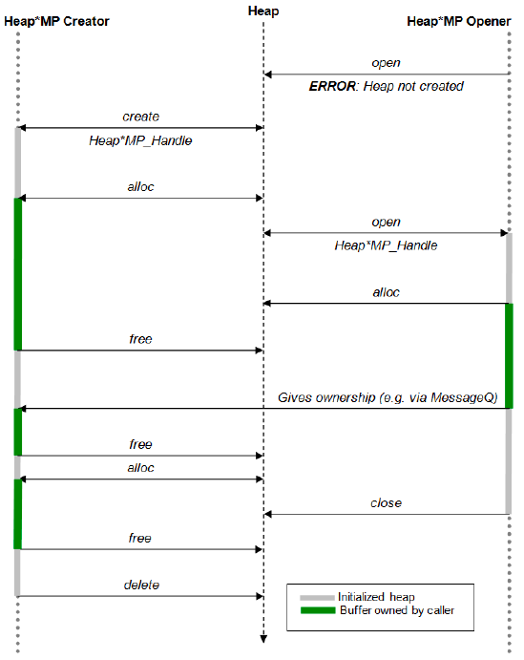
Heap*MP：
HeapBufMP_Params_init(&heapBufMPParams);
heapBufMPParams.regionId = 0; /* use default region */
heapBufMPParams.name = "myHeap";
heapBufMPParams.align = 256;
heapBufMPParams.numBlocks = 40;
heapBufMPParams.blockSize = 1024;
heapBufMPParams.gate = NULL; /* use system gate */
heapHandle = HeapBufMP_create(&heapBufMPParams);
MessageQ_registerHeap(heapHandle,HEAPID);
...
HeapBufMP_delete(&heapHandle)
HeapBufMP_open("myHeap", &heapHandle); ... HeapBufMP_close(&heapHandle);
HeapBufMP_alloc(heapHandle, size, align);
... HeapBufMP_free(heapHandle,blockPtr, size);
Memory & SharedResion：
buf = Memory_alloc(SharedRegion_getHeap(0) or heapHandle, size, 128, NULL); Memory_free(heapHandle,buf, size);

Slide 12
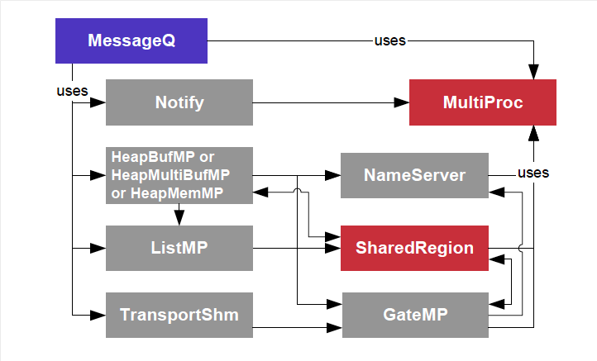
4. MessageQ
MessageQ：可变长的结构化消息通信

Slide 13
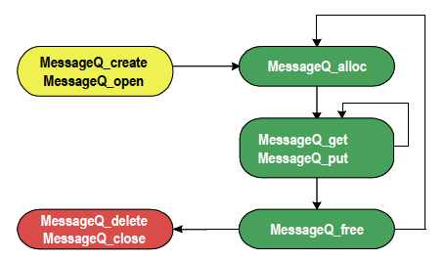
MessageQ Reader:
从 MessageQ 读取消息的线程（只能1个）
调用：MessageQ_create(), MessageQ_get(), MessageQ_free(), MessageQ_delete()
MessageQ Writer:
往 MessageQ 写入消息的线程（可以多个）
调用：MessageQ_open(), MessageQ_alloc(), MessageQ_put(), MessageQ_close()

Slide 14
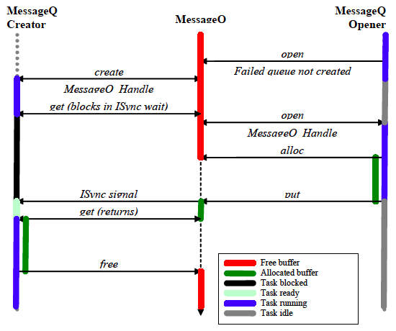
MessageQ：
syncSemHandle = SyncSem_create(NULL, NULL);
MessageQ_Params_init(&messageQParams);
messageQParams.synchronizer = SyncSem_Handle_upCast(syncSemHandle);
messageQ = MessageQ_create(CORE0_MESSAGEQNAME, &messageQParams); MessageQ_registerHeap(heapHandle,HEAPID); ... msg = MessageQ_alloc(HEAPID, sizeof(MessageQ_MsgHeader)); status = MessageQ_put(remoteQueueId, msg);
... MessageQ_unregisterHeap(heapHandle);
MessageQ_delete(&messageQ)
MessageQ_open(CORE0_MESSAGEQNAME, &remoteQueueId);
status = MessageQ_get(messageQ, &msg, MessageQ_FOREVER);
...
replyMessageQ = MessageQ_getReplyQueue(msg);
MessageQ_free(msg);
msg = MessageQ_alloc(HEAPID, sizeof(MessageQ_MsgHeader));
status = MessageQ_put(replyQueue, msg);
...
MessageQ_close(&messageQ);
typedef struct MyMsg {
MessageQ_MsgHeader header; // Required
SomeEnumType type // It can be any field
... // ...
} MyMsg;

Slide 15
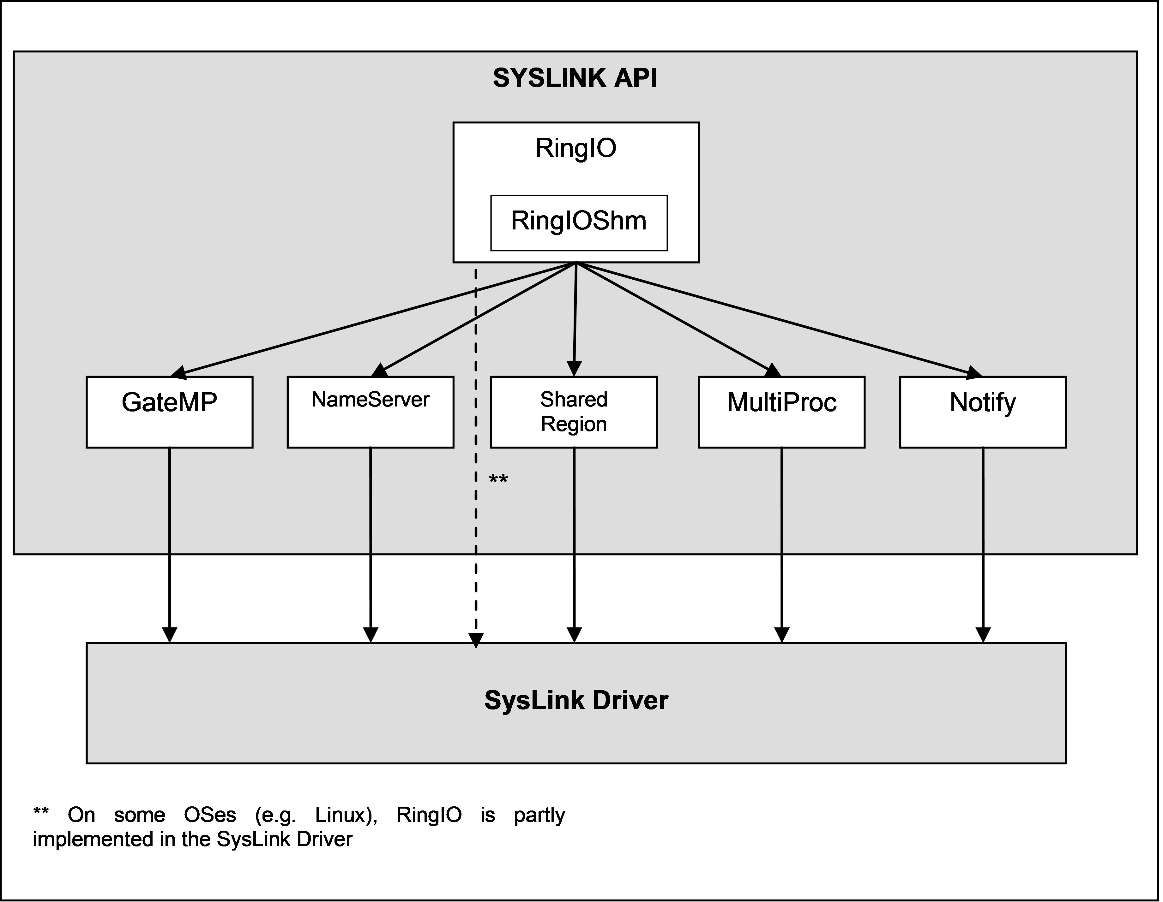
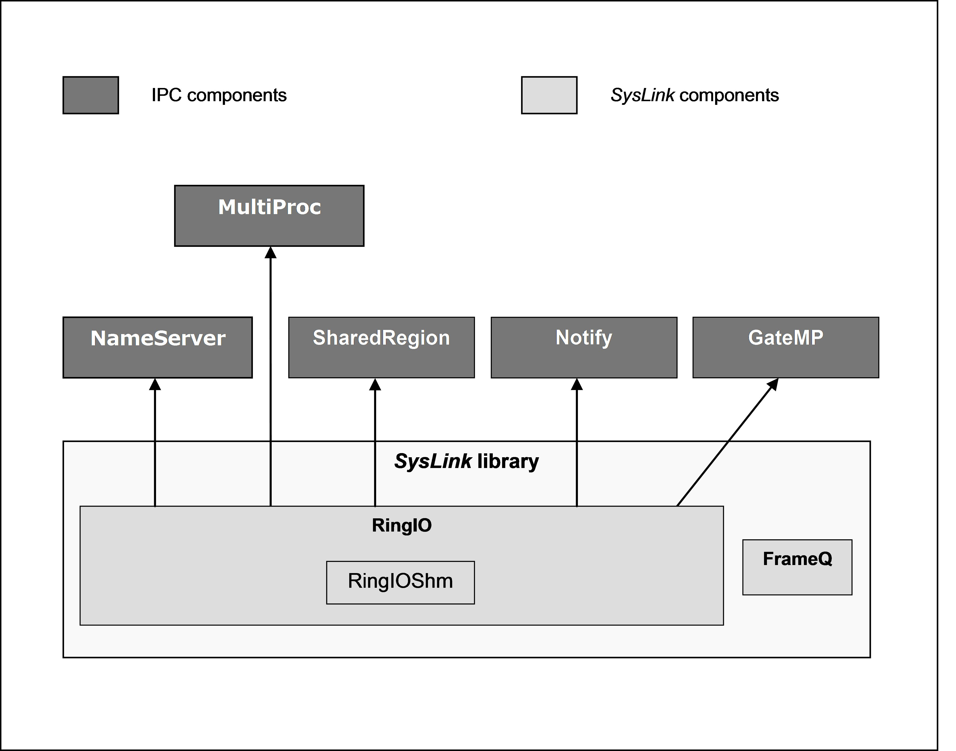
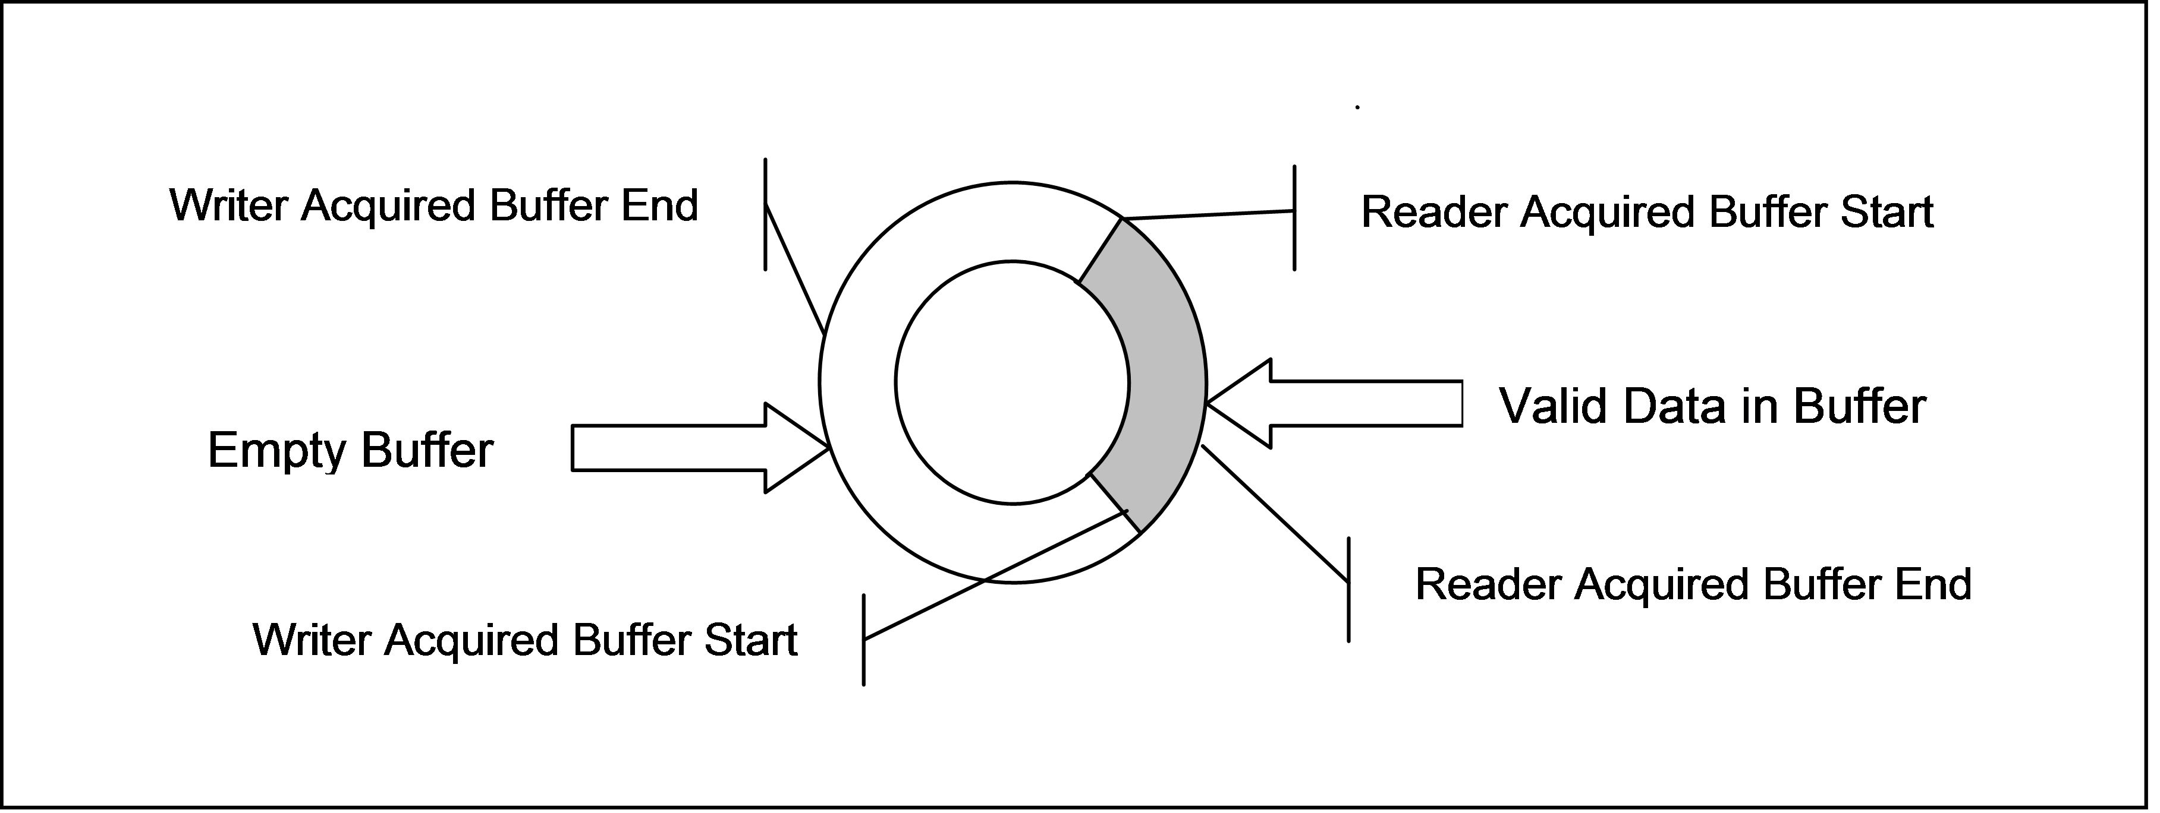
5. RingIO
RingIO:基于数据流的循环缓冲区

Slide 16
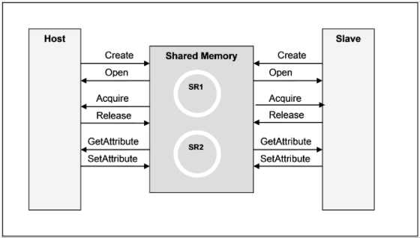
0. heapMemParm.size = 0x20000 (在配置文件 xxx.cfg 增大默认堆大小)
初始化 SysLink
SysLink_setup();
建立 RingIO 实例
RingIOShm_Params params;
RingIOShm_Params_init(&params);
params.commonParams.name = RING_BUF_NAME;
params.ctrlRegionId = SHARE_REGION1;
params.dataRegionId = SHARE_REGION1;
params.attrRegionId = SHARE_REGION1;
params.attrSharedAddrSize = ATTR_BUF_SIZE;
params.dataSharedAddrSize = DATA_BUF_SIZE;
params.remoteProcId = PROC_ID;
params.gateHandle = NULL; /* used default */
m_handle = RingIO_create(&params);
打开操作（读/写）句柄
RingIO_openParams params;
params.openMode = RingIO_MODE_READER or RingIO_MODE_WRITER;
params.flags = 0;
RingIO_open (name, &params, NULL, &read or write handle)
写数据（只允许一个线程进行写操作）
RingIO_acquire(write_handle, (RingIO_BufPtr*)buffer, &size);
… // fill data to buffer
RingIO_release(write_handle, size);
读数据（只允许一个线程进行读操作）
RingIO_acquire(read_handle, (RingIO_BufPtr*)buffer, &size);
… // retrieve data from buffer
RingIO_release(read_handle, size);
设置属性
RingIO_setAttribute(write_handle, type, param, needNotification);
获取属性
RingIO_getAttribute(read_handle, &type, &param);
丢弃数据
RingIO_flush(read or write handle, doHardFlush, &type, &param, &bytesFlushed);
关闭 操作（读/写）句柄
RingIO_close(&read or write handle);
删除 RingIO 实例
RingIO_delete(&m_handle);
释放 SysLink
SysLink_destroy();

Slide 17
6. MultiProc & ProcMgr & Cache
对从处理器内存的读写:
Host:
// Get slave_buffer_addr
... id = MultiProc_getId(process_name);
ProcMgr_open(&procHandler, id);
ProcMgr_read(procHandler, slave_buffer_addr, &size, local_buffer_addr);
ProcMgr_write(procHandler, slave_buffer_addr, &size, local_buffer_addr);
ProcMgr_close(&procHanler);
Slave:
/* invalidate cache before filling shared_buffer_addr at firstime */
Cache_inv(shared_buffer_addr, size, Cache_Type_ALLD, TRUE);
// Fill shared_buffer_addr
...
Cache_wbInv(shared_buffer_addr, size, Cache_Type_ALLD, TRUE);

Slide 18
7. NameServer
基于键值对的数据共享：
NameServer_Handle handle;
NameServer_Params params;
NameServer_Params_init(&params);
params.tableHeap = HeapStd_Handle_upCast(myHeap);
params.maxRuntimeEntries = 10;
handle= NameServer_create(“table_name”, &params);
// or NameServer_getHandle (name)
// 存储数据
// NameServer_add (handle, name, buf, len)
// NameServer_addUInt32 (handle, name, value)
key = NameServer_addUInt32(handle, "foo", 5);
// 获取数据
// NameServer_get (handle, name, buf, &len, &procIds)
// NameServer_getUInt32 (handle, name, buf, &procIds) // NameServer_getLocal (handle, name, buf, &len)
// NameServer_getLocalUInt32 (handle, name, buf) UInt16 queryList[2] = {1, MultiProc_INVALIDID};
count = NameServer_get(handle, "foo", &value, &len, queryList);
UInt16 queryList[2] = {1, MultiProc_INVALIDID};
count = NameServer_getUInt32(handle, "foo", &value, queryList);
// 移除数据
// NameServer_remove (handle, name)
// NameServer_removeEntry (handle, entry)
NameServer_removeEntry(handle, key);
NameServer_remove(handle, "foo");
NameServer_delete (&handle)

Slide 19
8. List & Gate
线程安全的双向链表操作
/* This structure can be added to a List because the first
* field is a List_Elem. Declared globally. */
typedef struct Rec {
List_Elem elem;
Int data;
} Rec;
List_Handle myList; /* in main() */
Rec r1, r2;
Rec* rp;
r1.data = 100;
r2.data = 200;
/* No parameters are needed to create a List. */
myList = List_create(NULL, NULL);
/* Add r1 and r2 to the back of myList. */
List_put(myList, &(r1.elem));
List_put(myList, &(r2.elem));
/* get the records and print their data */
while ((rp = List_get(myList)) != NULL) {
System_printf("rec: %d\n", rp->data);
}
--------------------------------------------------------------
/* Begin protection against modification of the List */
key = Gate_enterSystem();
while ((elem = List_next(myList, elem)) != NULL) {
System_printf("rec: %d\n", rp->data);
}
/* End protection against modification of the List */
Gate_leaveSystem(key);

Slide 20
9. 关于组件配置
1、配置文件 xxx.bld、xxx.cfg简析
ad7606/shared/config.bld
ad7606/dsp/dsp.cfg
2、模块配置示例（RTOS 与 HLOS 配置需一致）
RTOS (xxx.cfg) :
var SharedRegion = xdc.useModule('ti.sdo.ipc.SharedRegion');
SharedRegion.numEntries = 16;
HLOS (syslink_2_21_01_05/packages/ti/syslink/family/hlos/knl/omapl1xx/Platform.c):
Platform_overrideConfig 函数（第530行）：
... config->sharedRegionConfig.numEntries = 16;
需重新编译 SysLink内 核模块
3、配置的一般原则
进行动态配置（用 C 代码在应用程序里面配置）

Slide 21
更多 SysLink/IPC 组件的特点、应用场合以及 API 介绍请参看创龙 MCSDK开发入门文档：
《omapl138的多核软件开发组件mcsdk开发入门》

